Slide 1
A Take on SignalR
Iurii Khrystiuk

Slide 2
Agenda
Introduction
It’s that simple
Points of interest
What’s the catch?
Example
Conclusion
Q&A

Slide 4
Introduction
Released in 2013
Set of .Net and UI libraries
Real-time web communication
Multiple fallback protocols

Slide 5


Slide 6
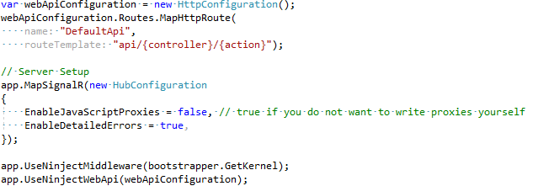
It’s That Easy: Server
OWIN integration
Separate pipeline

Slide 7
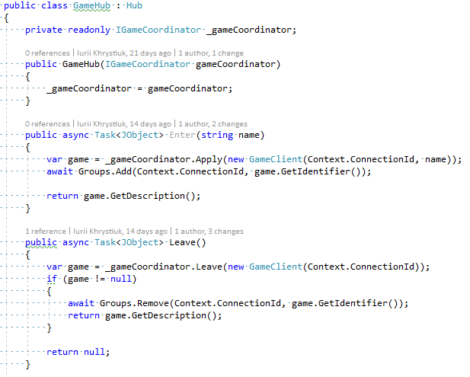
It’s That Easy: Hub
Custom hub has to inherit “Hub” class
Access to connection context
Groups management
Events management

Slide 8
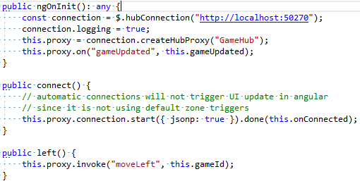
It’s That Easy: Client

Slide 9
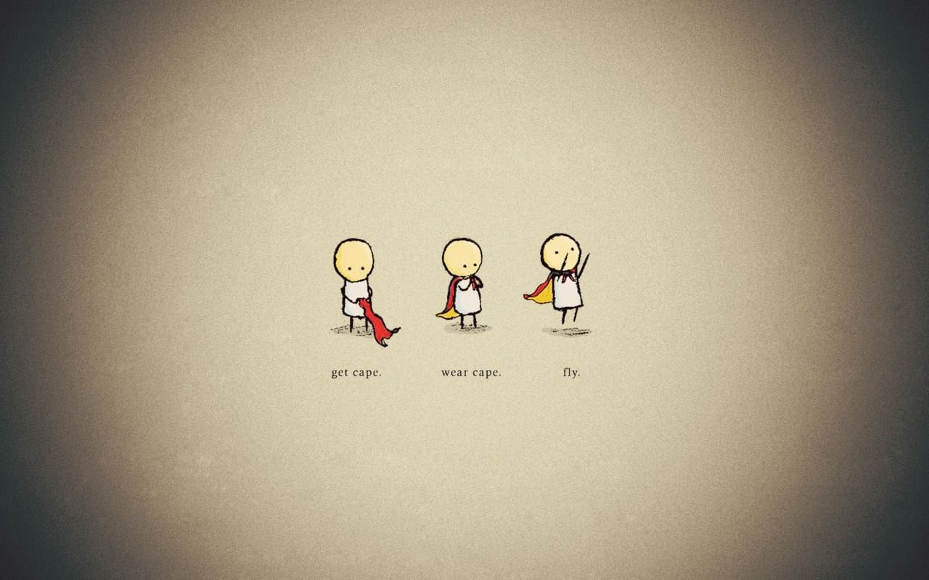

Slide 10
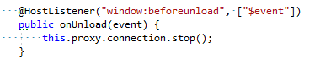
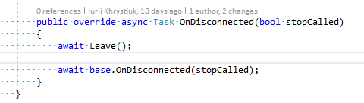
Points of interest
Hub Lifetime
Per request scope
No resources can be cached or saved in instance!
Connection management

Slide 11
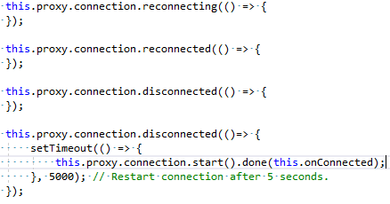
Points of interest
Events handling
Documentation
Every API is documented
Very helpful examples
Enough to get started

Slide 12


Slide 13
What’s the catch: .Net vs .Net Core
ASP.NET versions supported
OWIN is required
Dependent on jQuery
UI libraries are not UMD compatible
SPA integration is tricky

Slide 14
What’s the catch: Miscellaneous
Web Sockets are tricky
DI with SignalR
Client state management

Slide 15
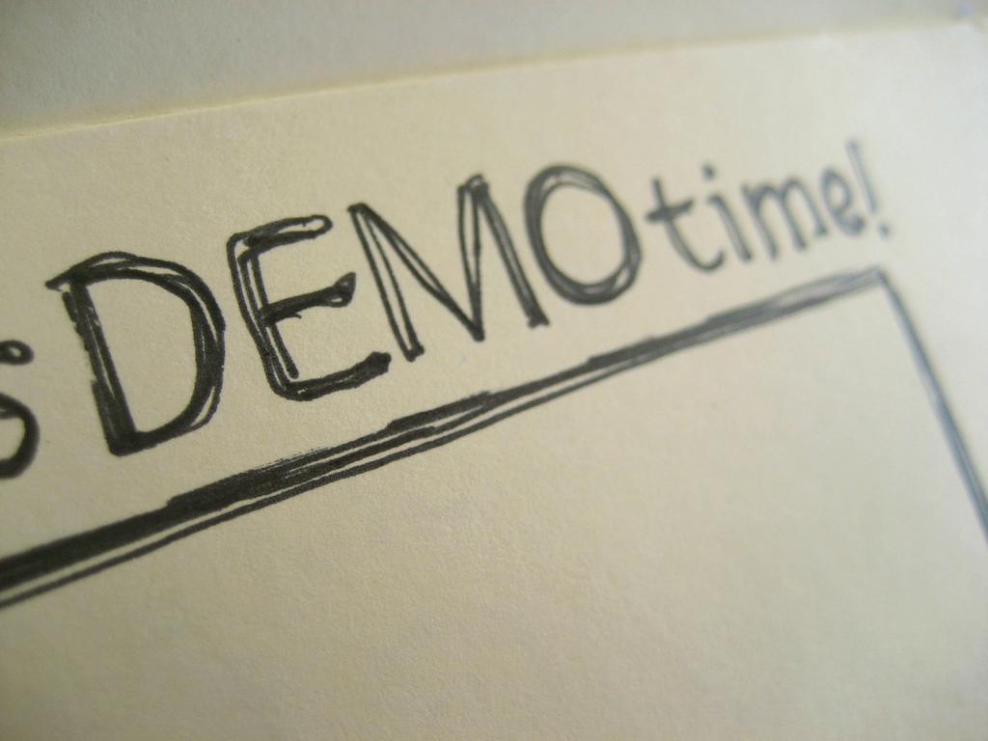

Slide 17
Useful Links
https://docs.microsoft.com/en-us/aspnet/signalr/
https://github.com/iuriikhrystiuk/conference/tree/develop/TalkIT-31-05-2017

Slide 18
Thank You!

